Slide 1
Human Gender And Age Detection from Facial Images Using Convolution Neural Network
CS6301 MACHINE LEARNING
SRIVATSAV R (20191035066)
SACHIN RAGHUL T (2019103573)
SANJEEV K M (2019103576)

Slide 2
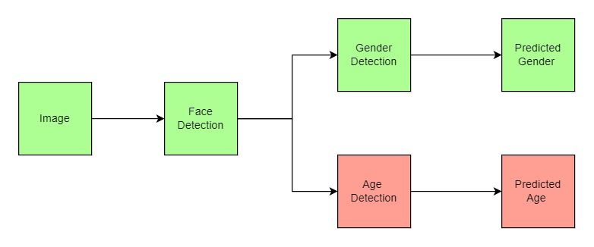
BLOCK DIAGRAM
Dataset : Age and Gender Kaggle Dataset

Slide 3
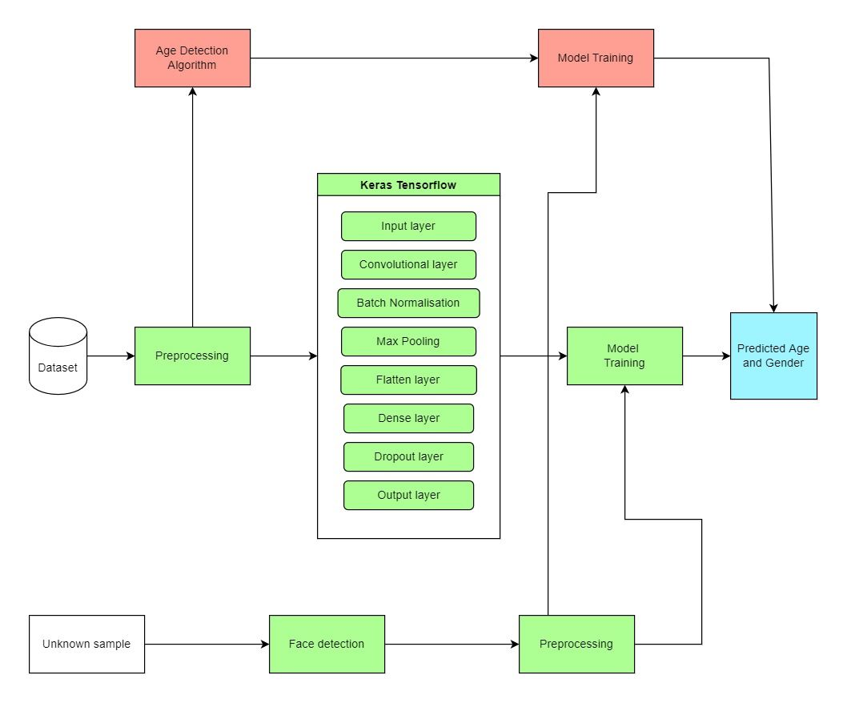
DETAILED BLOCK DIAGRAM

Slide 4
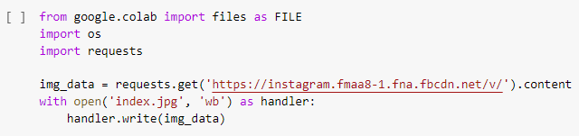
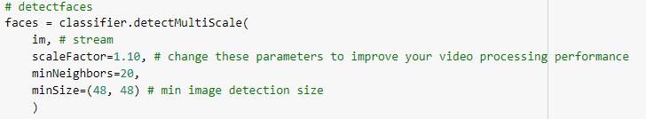
ALGORITHM (PREPROCESSING RAW DATA)
Download the source image from the url using python request module
Using OpenCV detect and extract the faces from the source image loaded

Slide 5
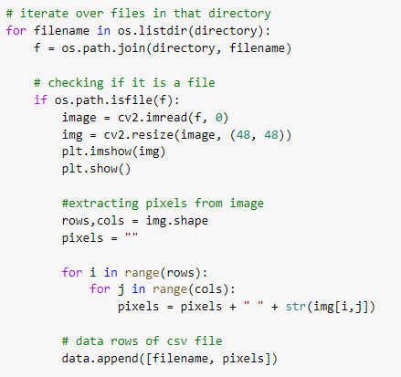
Reduce and compress the extracted image using resize module in OpenCV
Convert the processed image to greyscale pixel data
Insert each detected face pixel data into a csv file through iteration

Slide 6
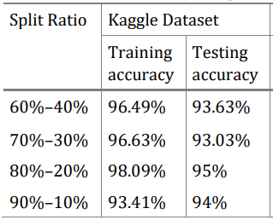

ALGORITHM (TRAINING THE KERAS MODEL)
Import training dataset and split into train and test data (80%, 20%) and convert pixel values between 0 and 1
Feed the training set to keras model (tensorflow) through sequential module

Slide 7
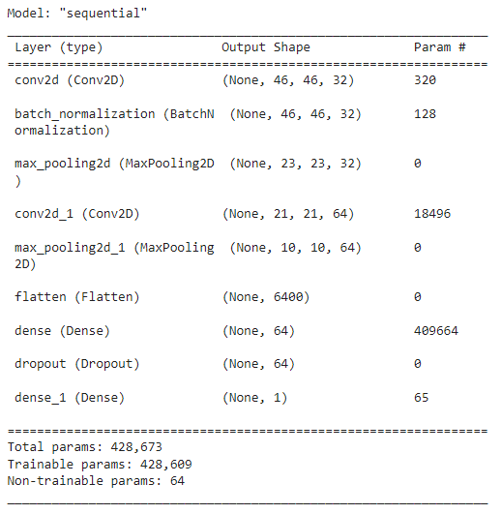
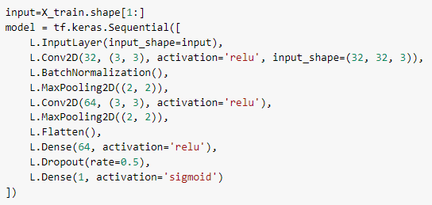
KERAS
Keras is an open-source software library that provides a Python interface for artificial neural networks. Keras acts as an interface for the TensorFlow library.
SEQUNTIAL MODULE LAYERS

Slide 8
The images are of size 48 x 48. You convert the image matrix to an array, rescale it between 0 and 1, reshape it so that it's of size 48 x 48 x 1, and feed this as an input to the network.
You'll use two convolutional layers:
The first layer will have 32-3 x 3 filters,
The second layer will have 64-3 x 3 filters and
In addition, there are two max-pooling layers each of size 2 x 2.
Also the model contains BatchNormalization, Flatten and Dropout layers in the sequential module

Slide 9
MODULE EXPLAINED..
SEQUENTIAL MODULE
Sequential groups a linear stack of layers into a “tf.keras.Model”. Sequential provides training and inference features on this model.
CONVOLUTIONAL LAYERS (Conv2D)
Convolutional neural networks apply a filter to an input to create a feature map that summarizes the presence of detected features in the input.
MAX POOLING (2D)
Downsamples the input along its spatial dimensions (height and width) by taking the maximum value over an input window

Slide 10
BATCH NORMALIZATION
Batch normalization applies a transformation that maintains the mean output close to 0 and the output standard deviation close to 1.
FLATTEN LAYER
A flatten operation on a tensor reshapes the tensor to have the shape that is equal to the number of elements contained in tensor non including the batch dimension.
DROPOUT LAYER
The Dropout layer randomly sets input units to 0 with a frequency of rate at each step during training time, which helps prevent overfitting

Slide 11
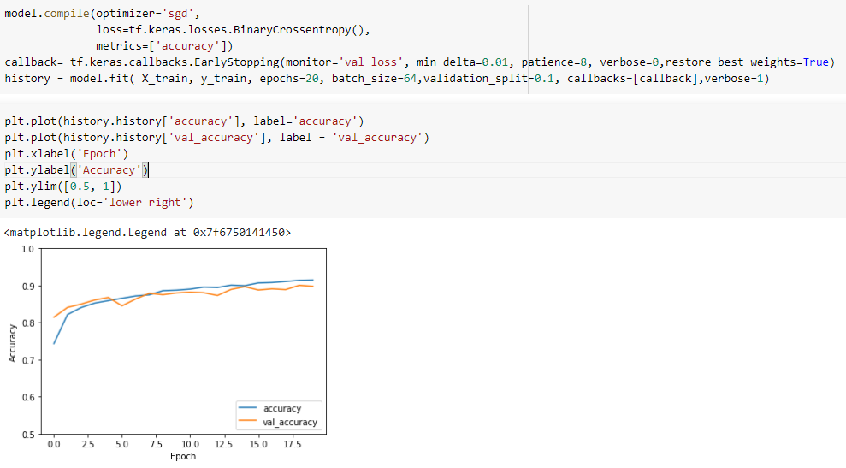
Training the keras model
The model is trained using batch size of 64 also a higher batch size of 128 or 256 is also preferable it all depends on the memory. It contributes massively to determining the learning parameters and affects the prediction accuracy. So, this model is trained using 20 epochs so that the model doesn’t overfit.

Slide 12

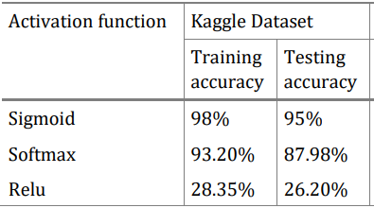
Formula involved
Sigmoid function
Sigmoid function gives higher accuracy on gender detection dataset

Slide 13
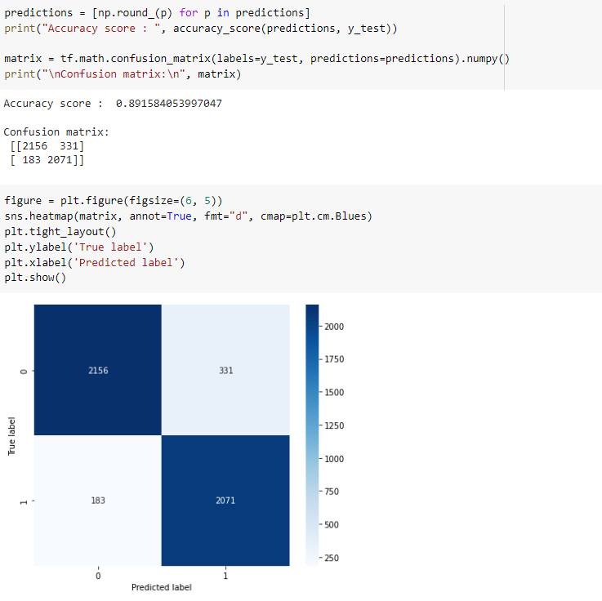
Performance metrics
Accuracy score

Slide 14
Confusion matrix

Slide 15
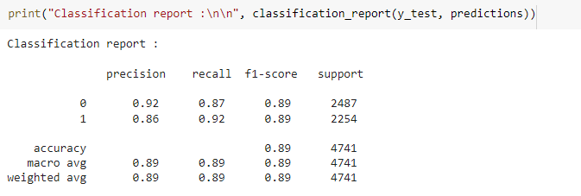
Classification report

Slide 16
references
Project source files
Model Training
Face Detection
Testing interface
Dataset
Base paper
Human Gender And Age Detection
References
G. Levi, and T. Hassner,” Age and Gender Classification Using Convolutional Neural Networks,” IEEE Workshop on Analysis and Modeling of Faces and Gestures (AMFG), IEEE Conf. on Computer Vision and Pattern Recognition (CVPR), Boston, 2015.
Developer guides (keras.io)
Module: tf | TensorFlow Core v2.7.0

Slide 17
Thank you ☺

